Slide 1
SSW-810: Software Engineering Tools and Techniques
Course Overview
Prof. Jim Rowland
Software Engineering
School of Systems and Enterprises

Slide 2

Today’s Topics
Who am I?
Course motivations and goals
What will we learn?
How will we learn it?
Social Media assignments

Slide 3
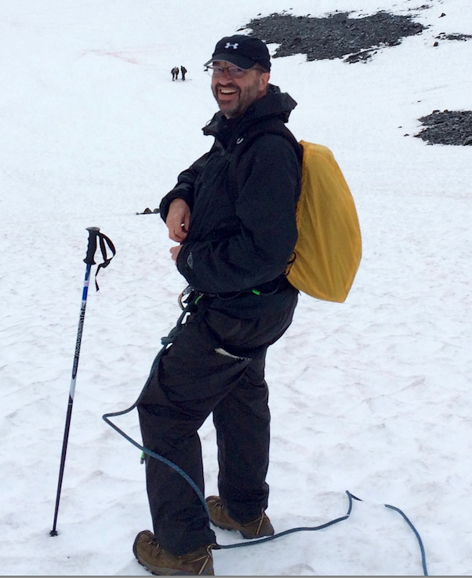
Who am I?
35 years exploring technology and building software
Director Applied Data Mining Research – AT&T Research
Bell Labs Distinguished Member of Technical Staff
My work has been featured in
New York Times
Time Magazine
Communications of the ACM
MoMA – Museum of Modern Art
Travel – South Africa to Alaska
Build and play guitars

Slide 4

Course motivations and goals
Software skills are critical for all fields
Learn programming with Python
Learn software engineering tools and techniques to make software development, debugging, testing, and maintenance easier and more efficient
Prepare you for later courses and your career

Slide 5

What will you learn?
Programming with Python
Debugging tools and strategies
Print is not always the best answer
Testing tools and strategies
Object Oriented Analysis and Design
Managing software projects with GitHub
Introduction to using databases
Relational databases
NoSQL databases

Slide 6
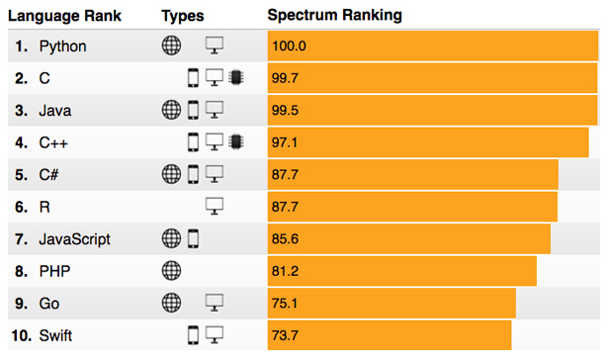
Why Python?
2017 Top Programming Languages of IEEE Spectrum readers
http://spectrum.ieee.org/computing/software/.WXDc1kb1jqQ.mailto

Slide 7

How do we do it?
Experiment!
Write lots of programs
Fail more than once
Analyze other people’s programs
Explore/Continuous Learning

Slide 8

Class Mechanics
Weekly lectures
Weekly quizzes on new material
Weekly programming assignments
Programming project
Spanning several weeks
Social Media assignments
Final exam

Slide 9
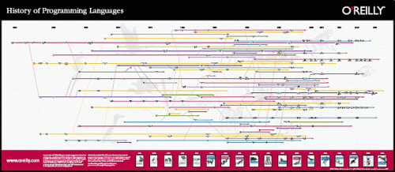
Continuous learning
Technology moves quickly and you must keep up!

Slide 10


Social Media assignments
Technology changes quickly
You need to keep up!
Find an relevant article
Summarize the article
Make a recommendation

Slide 11

Ideas for social media topics
Topics should be related to Software Engineering
Retrospective, current, or emerging topics
Potential topics include:
Programming languages
Python packages
Tools or techniques

Slide 12

Grades
Component | Weight
Quizzes | 15%
Homework | 40%
Social Media | 10%
Final Exam | 35%
Total | 100%

Slide 13
Late assignments
All assignments are due at the same time each week so you can plan your schedule
Late assignments will be assessed a 5% penalty for each 24 hour period that the assignment is late

Slide 14

Plagiarism and Cheating
Do your own work
All work must be expressed in your words
Don’t copy answers from lecture or web
Use the web as a tool, not a replacement for thinking
I employ tools to detect plagiarism and cheating
Software Engineering is all about trust

Slide 15
Consequences of Cheating
First offense:
0 for the assignment/quiz/exam
Second offense:
Academic Integrity Board Review
Possibly fail the course
Possible expulsion from the university

Slide 16

Questions?

